Slide 1
WordSense.io — The Semantic Guess Game
J057 – Shanel Fernandez
J058 – Shivane Singh
J075 – Yatharth Desai

Slide 2
Objective / Idea
The Goal of this project was to Create an interactive word-guessing game that uses semantic similarity to tell if a guessed word is close to the target.
“Instead of matching letters, it matches meaning.”

Slide 3
Key Features
Similarity Meter — shows how “close” your guess is in meaning
Temperature Feedback — “Hot,” “Warm,” “Cool,” “Cold”
Guess History — track all previous attempts
Hints — given every 3 guesses
Stats Tracking — streaks & best scores
Difficulty Levels — Easy / Medium / Hard
The Tech Behind It:
TensorFlow.js
Google Universal Sentence Encoder (USE)
HTML, CSS, JavaScript
LocalStorage for tracking stats

Slide 4
How It Works ???
Target Word is chosen secretly.
Player guesses a word.
App calculates semantic similarity between guess & target.
Displays:
“Correct!” if similarity = 1.0
“Close!” if similarity ≥ threshold
“Wrong!” otherwise
It displays Hot, Warm, Cool, Cold next to our guessed word
There are 3 modes of Difficulty: Easy, Medium, Hard
After 3 wrong guesses → Hint drops!
Hint types:
🔠 First letter reveal
🔤 Synonym clue
💭 Category hint (“It’s an animal!”)

Slide 5

The Model: Universal Sentence Encoder
Converts words into high-dimensional vectors (512-dim).
Input: “king” → Model → Output: 512-number vector
Words with similar meanings are “closer” in vector space
Example:
“king” ≈ “queen”, “ruler”
“king” ≠ “banana”, “car”
Cosine Similarity Formula:
$$\text{similarity}=\frac{A⋅B}{∥A∥∥B∥}$$
Measures the angle between two vectors.
1.0 → Same meaning
0.0 → Completely different

Slide 6
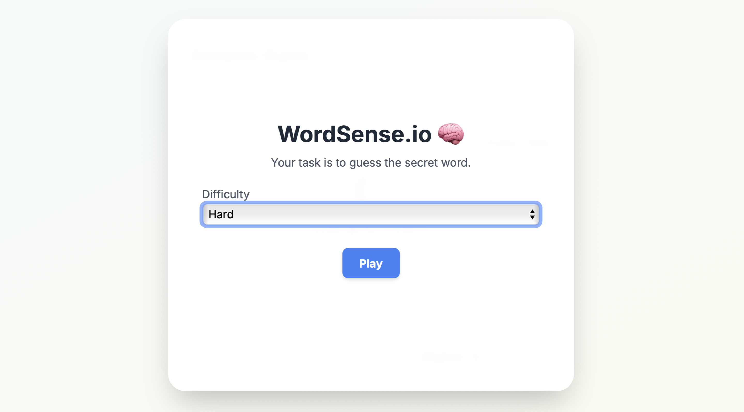
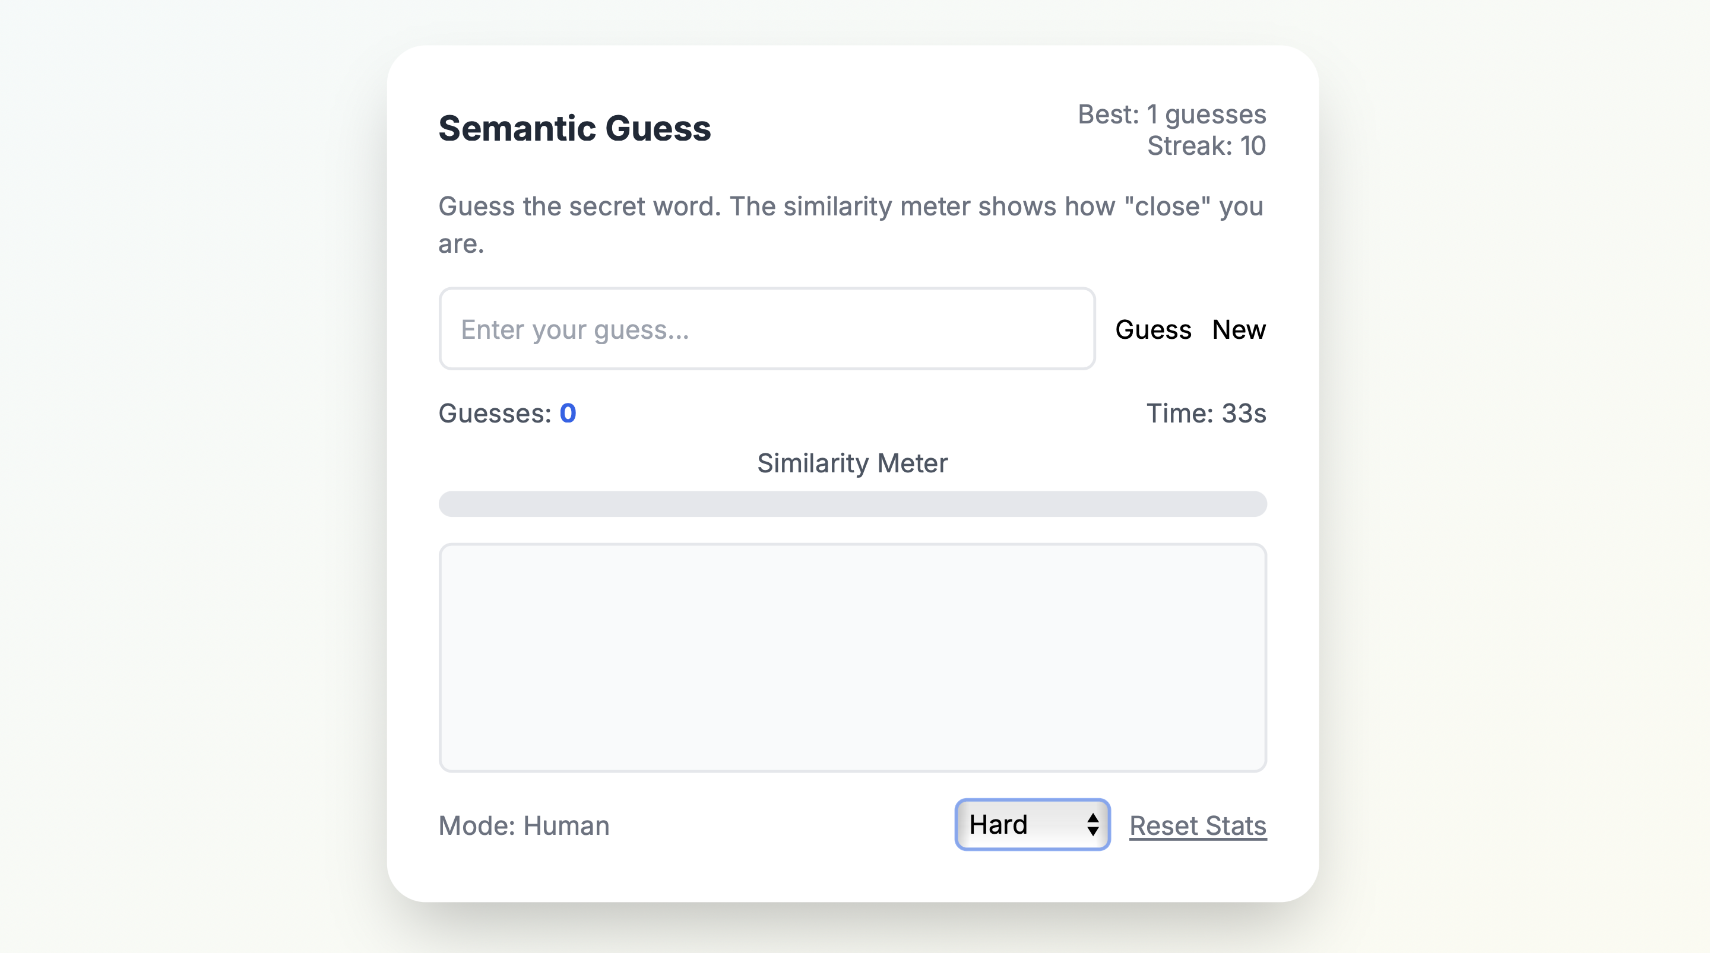
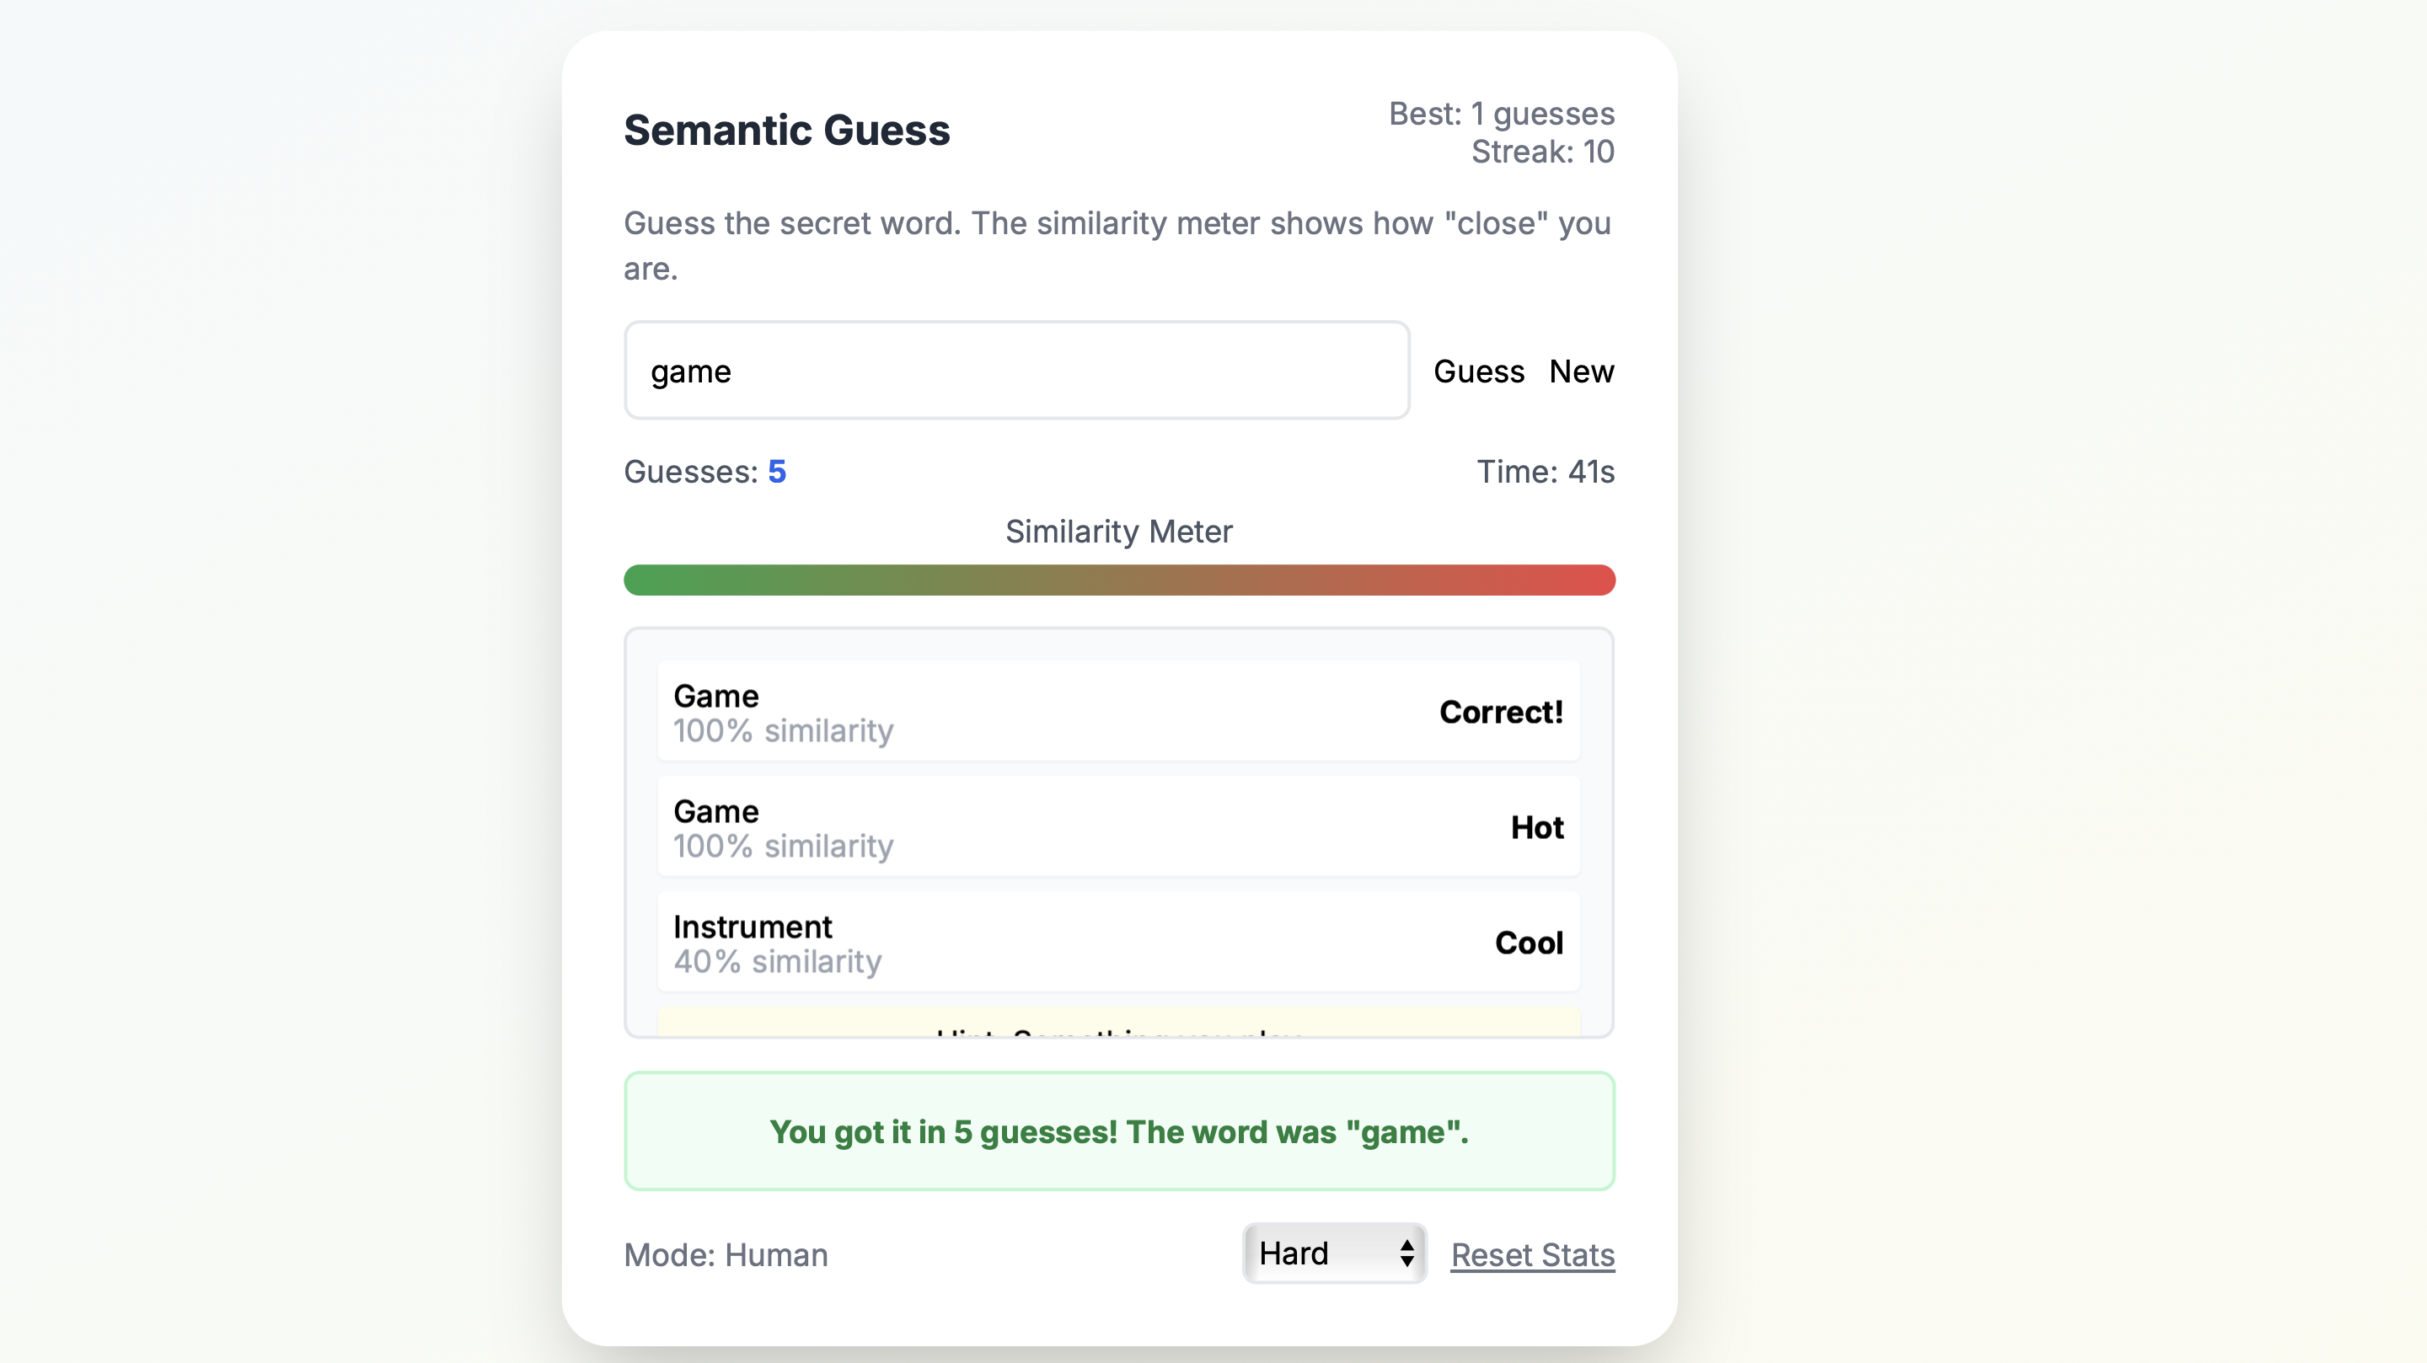

Slide 7
THANKS
DO YOU HAVE ANY QUESTIONS?
youremail@freepik.com
+91 620 421 838
yourcompany.com
Please, keep this slide for attribution

